Slide 1
Smart parking system
For smart cities
Presented by
Jahnavi.Ch
Hema.N
Sharanya.B

Slide 2
Agenda
What is a smart parking system?
Features
Benefits of smart parking system
Current scenario
Hardware description
applications
conclusion

Slide 3
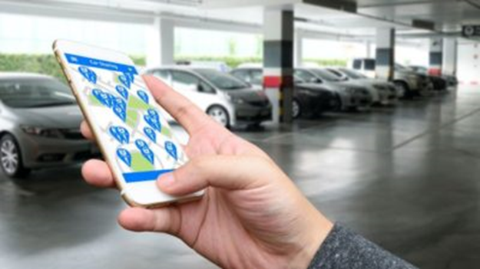
What is smart parking system?
It obtains information about available slots in the parking places
Process the data and guides the vehicles to available positions

Slide 4
features
Adequate information for drivers.
Reduction in searching time.
Reduces driver frustration.
Decreases traffic congestion.
Elimination of queues.
Increased revenue and profitability.
Appropriate pricing methods.

Slide 5
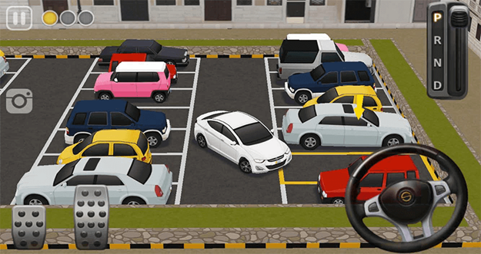
Benefits of smart parking system
We can reduce traffic
The driver need not to spend more time on parking space

Slide 6
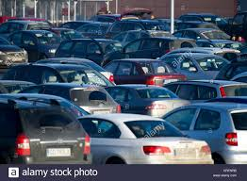
Current Scenario

Slide 7
Hardware description
Node-MCU:-
NodeMCU Development board is featured with wifi capability, analog pin, digital pins and serial communication protocols.
NodeMCU Dev Kit has Arduino like Analog (i.e. A0) and Digital (D0-D8) pins on its board.
It supports serial communication protocols i.e. UART, SPI, I2C etc.

Slide 8
Hardware description
Ultrasonic sensor:-
As the name indicates, ultrasonic sensors measure distance by using ultrasonic waves. The sensor head emits an ultrasonic wave and receives the wave reflected back from the target. Ultrasonic Sensors measure the distance to the target by measuring the time between the emission and reception.

Slide 9
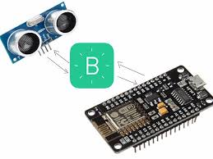
Node-MCU and ultrasonic sensor

Slide 10
Softwares Used
Arduino(version 1.8.9)
IBM Watson Service
MIT App inventor
Java Script

Slide 11
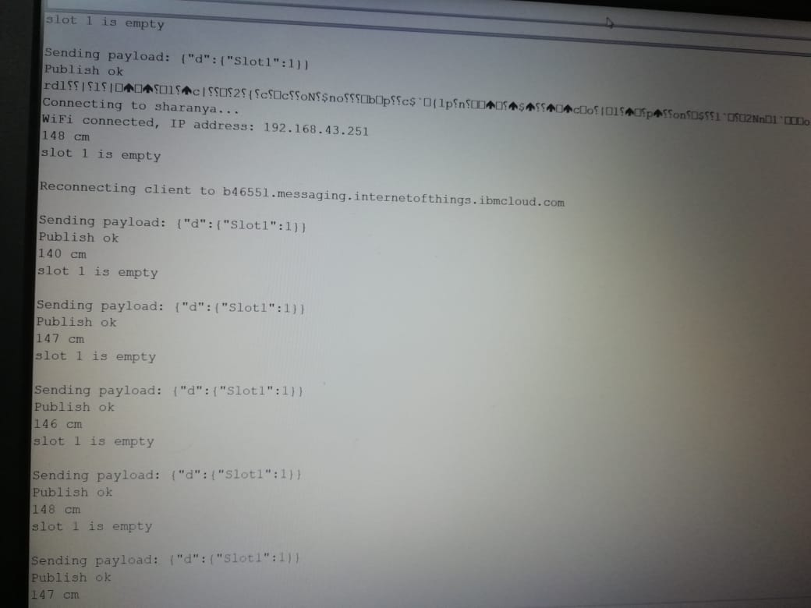
Sensor values at Serial Monitor

Slide 12
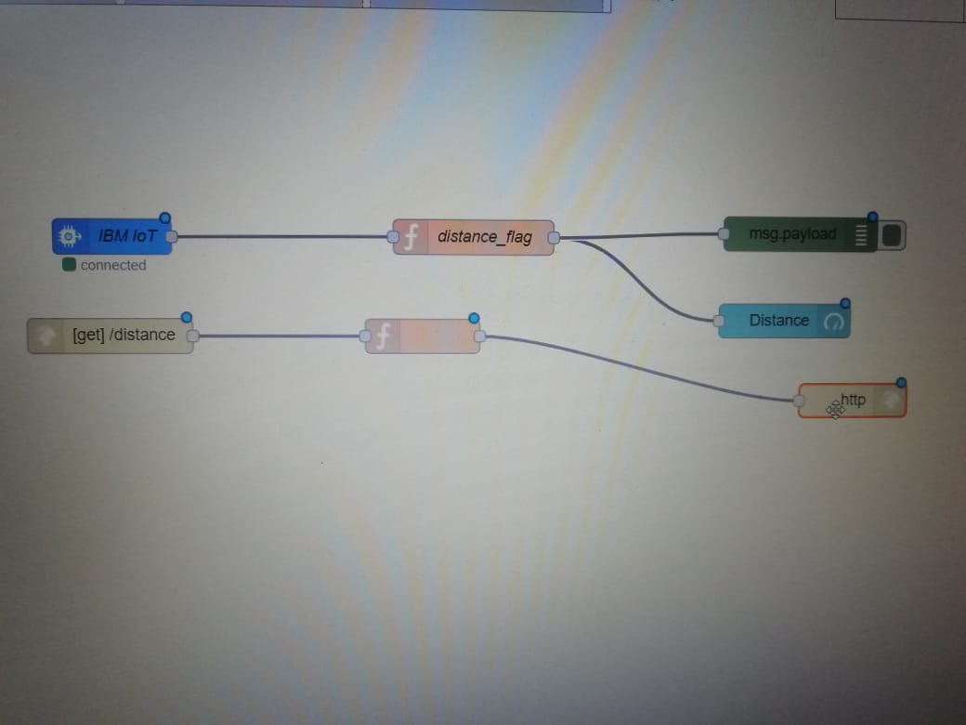
NodeRed Connections for user Interface

Slide 13
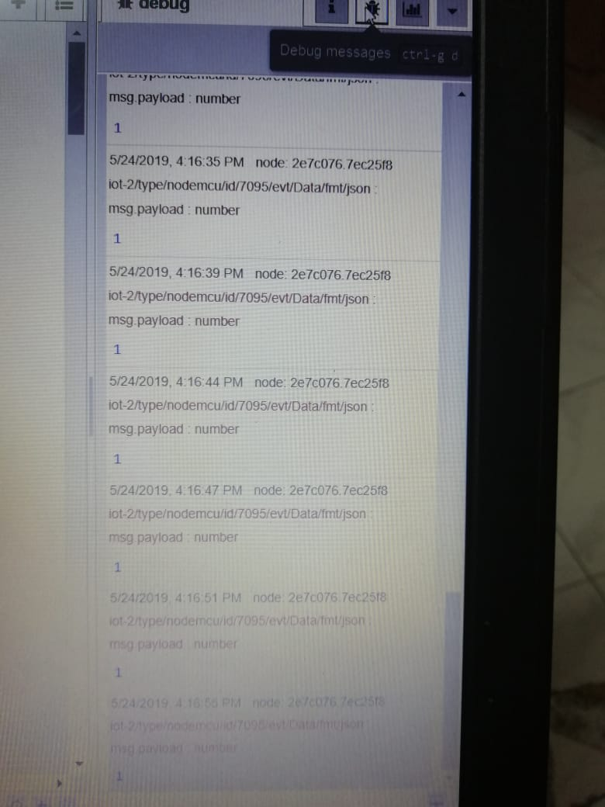
NodeRed Output

Slide 14
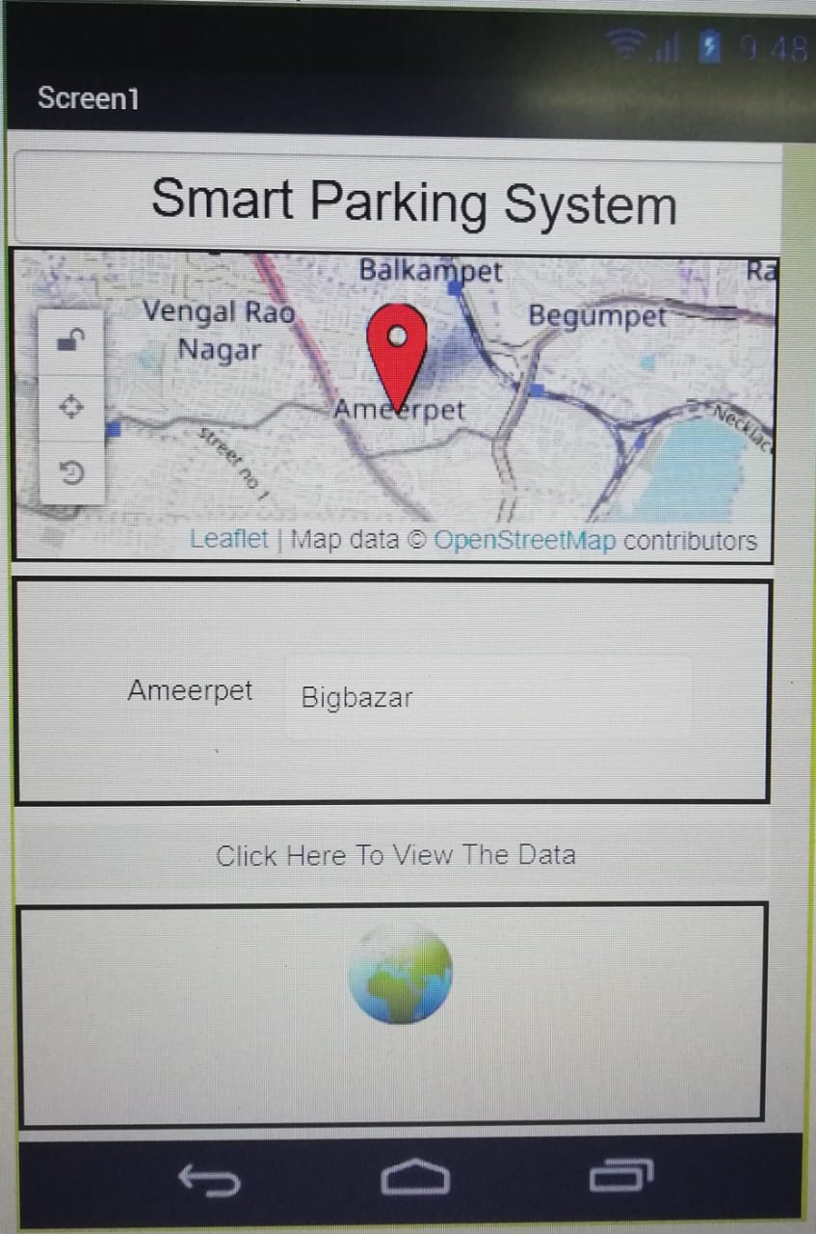
Mobile app

Slide 15

Applications
The smart parking system can be Implemented in :-
Shopping malls
Restaurants
Theaters….etc

Slide 16
Conclusion
So by the implimentation of this project,
We can Reduce Manual effort in finding out the empty slots.
Reduces Unnecessary travelling to find out the empty parking slot.
Acts as an efficient guide for parking.

Slide 17
Thank YOU

